Slide 1
SplitDeal
Revolutionizing Shared Shopping Experiences

Slide 2

Introduction
SplitDeal is a platform that allows shoppers to collaborate, create shared carts, and access exclusive discounts, enhancing their shopping experience.

Slide 3
Problem
01

Slide 4
Shoppers miss bulk discounts
Many consumers tend to shop alone, which prevents them from taking advantage of discount opportunities that require multiple purchases or bulk buying. This often leads to paying higher prices than necessary.

Slide 5
Expensive solo shopping
Shopping individually can become a financial burden, especially for budget-conscious consumers. Without the ability to pool resources or share costs, shoppers may find themselves unable to afford items they desire.

Slide 6

Coordination issues for shared purchases
Coordinating shared purchases among friends or family can be challenging. Different schedules, preferences, and communication gaps often result in missed opportunities for bulk deals. This can discourage shoppers from trying to collaborate, leading to a disjointed shopping experience.

Slide 7
02
Solution

Slide 8
Connects nearby shoppers
SplitDeal offers a unique platform that connects shoppers who are in close proximity, making it easier for them to find and collaborate with each other. By leveraging location-based technology, users can connect with potential shopping partners efficiently, maximizing the chances of accessing group discounts.

Slide 9
Shared carts for savings
Users can create shared shopping carts that allow multiple participants to contribute items. This system enables shoppers to combine their purchases, thereby qualifying for bulk discounts and saving money. It ensures that everyone involved can benefit from the reduced prices when shopping together.

Slide 10
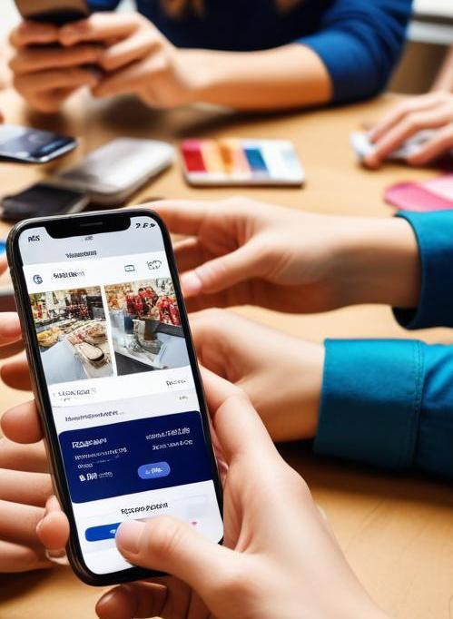
Secure payment and collaboration
The platform supports secure payment processing, allowing users to split costs seamlessly. Alongside real-time collaboration features, shoppers can communicate and coordinate their purchases effectively. Such tools empower users to make informed decisions together while ensuring that transactions are safe and reliable.

Slide 11

Conclusions
SplitDeal transforms the shopping experience by facilitating collaboration, maximizing savings, and engaging users in a social shopping environment. It addresses common pain points of solo shopping, turning transactions into enjoyable and cost-effective group activities.

